Slide 1
Creating truly accessible forms
Service Design in Government 2024
Caroline Jarrett
CJ on LinkedIn
@cjforms
Vicky Teinaki VT on LinkedIn
@vickytnz

Slide 2
Let’s introduce ourselves
We are Caroline and Vicky
Say hello to the people on your table

Slide 3
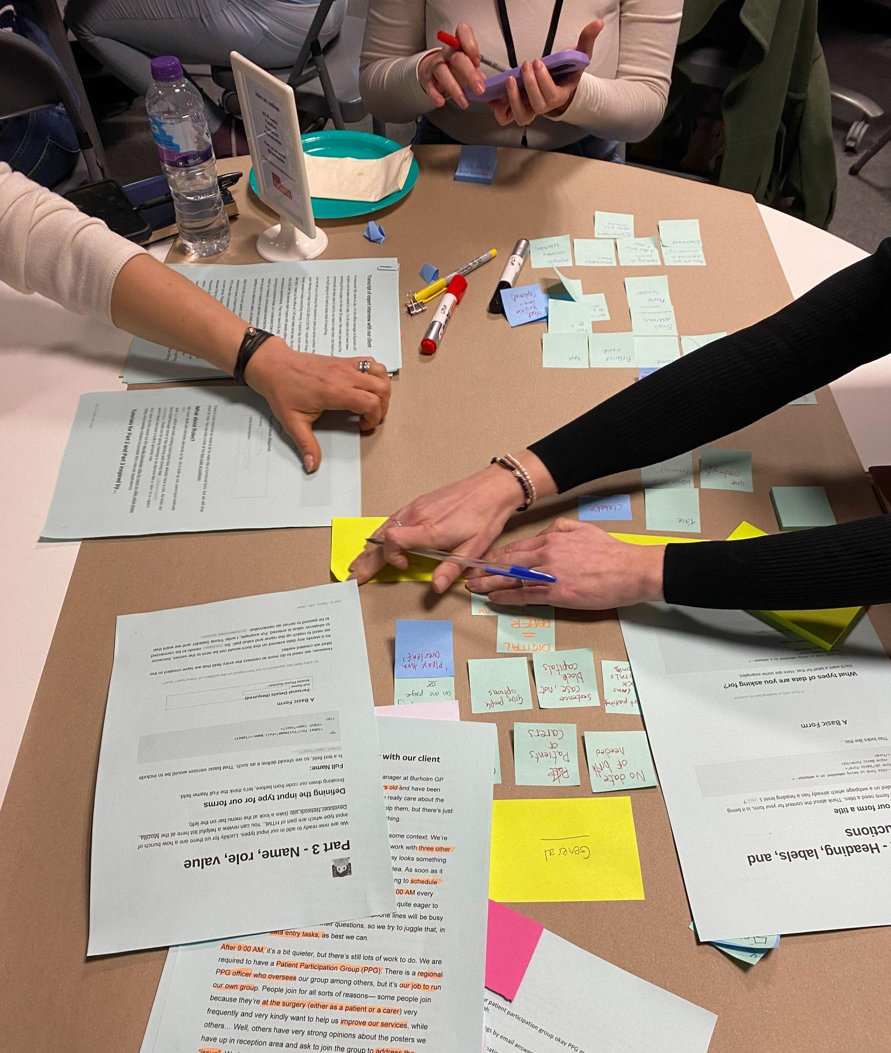
Ladies that UX Brighton ran a great in-person event
I’d like to thank everyone involved in preparing and running that event, the inspiration for this shorter workshop.
Blog post about the in-person event
Original workshop resources on Notion (Creative Commons licensed).
Find out more about Ladies that UX Brighton

Slide 4
Agenda
Introduction
Challenge 1: Think about types of disability
Challenge 2: Use the Web Content Accessibility Guidelines
Challenge 3: Use a Web Design System
Challenge 4: Think about why we ask for a phone number
Challenge 5: Make a question protocol
Challenge 6: Make a prototype
Challenge 7: Think about implementation (and code)
Wrap up

Slide 5
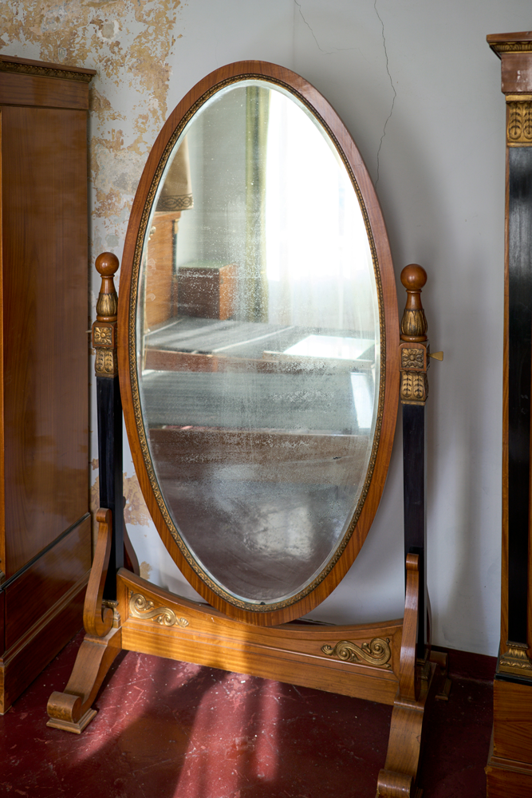
We’re going to try a form
Before we try it, we’ll think about:
Whether to be yourself or someone else
If yourself: Are you likely to fill in this form?
If someone else: How well do you know this person?
Whoever you choose to be, does that person represent real users?
Image credit: Steffen Lemmerzahl on Unsplash

Slide 6
Before we look at any form, decide on a person
Write a ‘once upon a time’ story, filling in these blanks
Today ____________ (name of a person)
decided to ____________ (do a task) because ____________ (reason for the task)
Optional: add an adjective about how they felt about it

Slide 7
Today we are all going to be Pat
Today Pat
decided to find out how to pay a parking ticket in Edinburgh because the actual ticket has gone missing
Optional: what adjective would you guess applies to Pat?

Slide 8
Now let’s try the task
Follow along as Pat tries to pay without the ticket
Keep a note of which page(s) on the website are the form

Slide 9
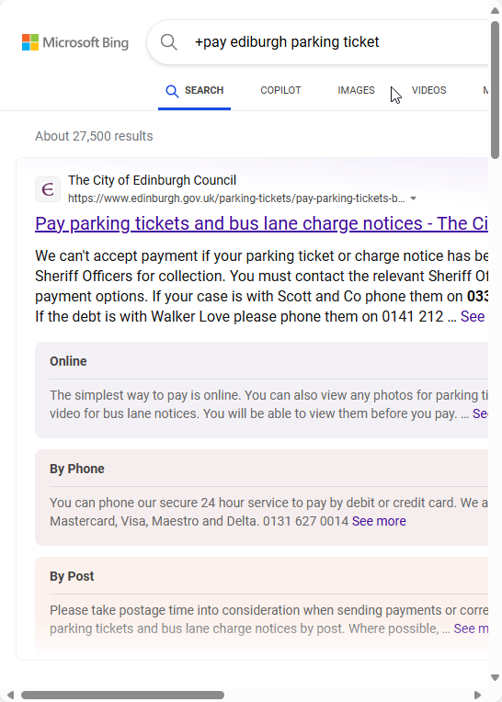
Is this (page 1) a form?

Slide 10
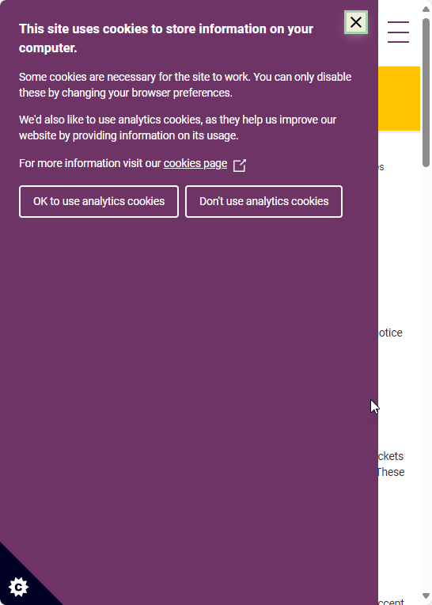
Is page 2 a form?

Slide 11
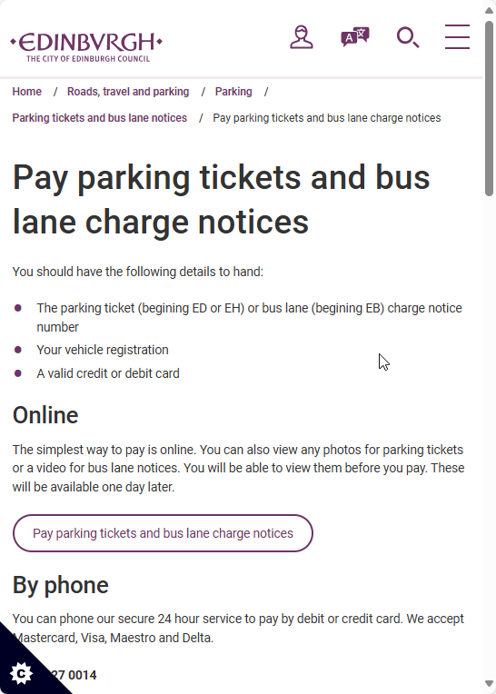
Is page 3 a form?
Pay parking tickets and bus lane charge notices – The City of Edinburgh Council

Slide 12
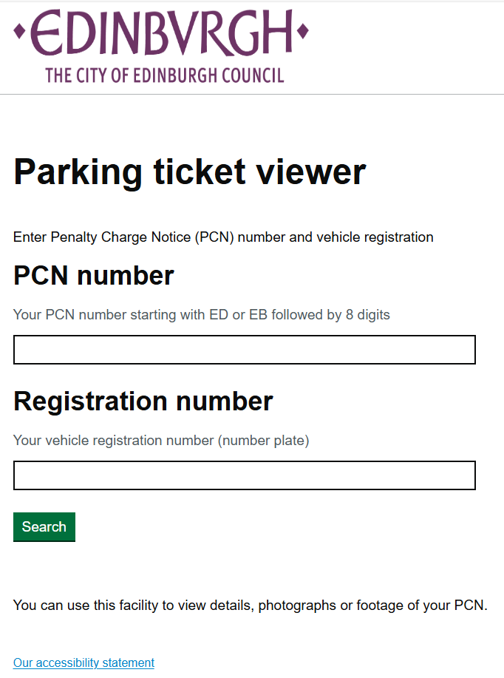
Is page 4 a form?
Parking ticket viewer - Pay PCN Home (itsvc.co.uk)

Slide 13
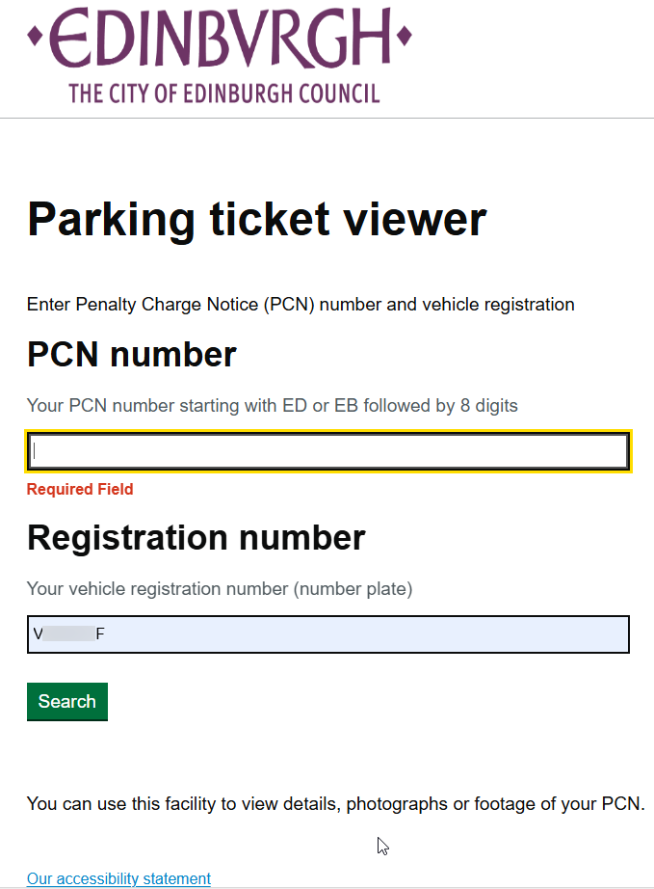
Is page 5 a form?

Slide 14
Which page(s) were the form?
1
2
3
4
5

Slide 15
We know a form when we see it
Looks like a form and works like a form
Asks questions and expects answers
Allows someone to achieve a goal

Slide 16
A good form needs a lot of accessibility
Interaction design
Content design
Service design

Slide 17
Takeaway
A good form is easy to:
read and use
understand and answer
get it done and move on

Slide 18
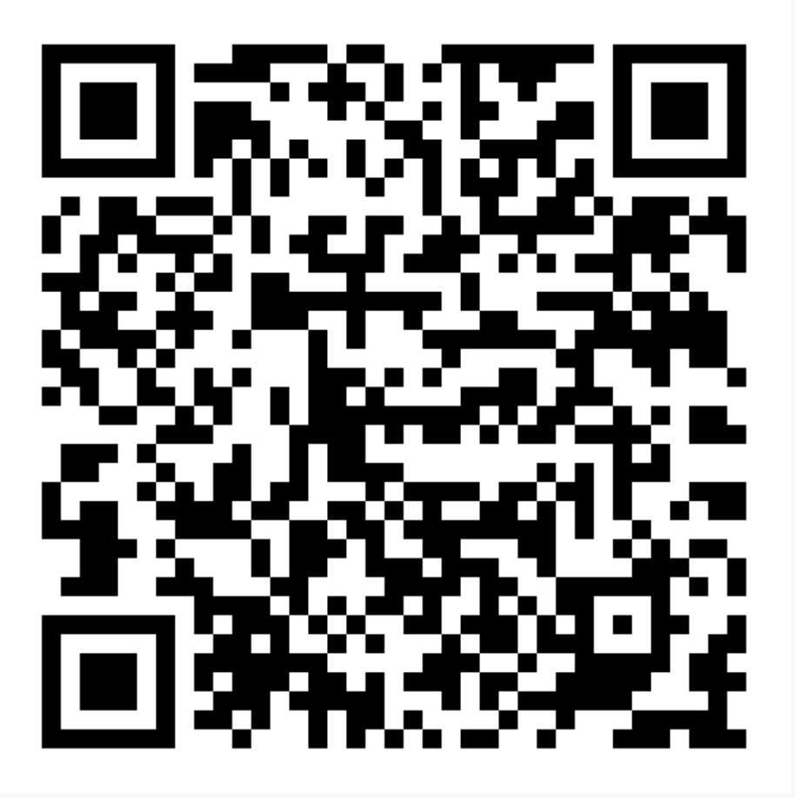
The form has an accessibility statement
https://edinburghocm.itsvc.co.uk/Home/Accessibility

Slide 19
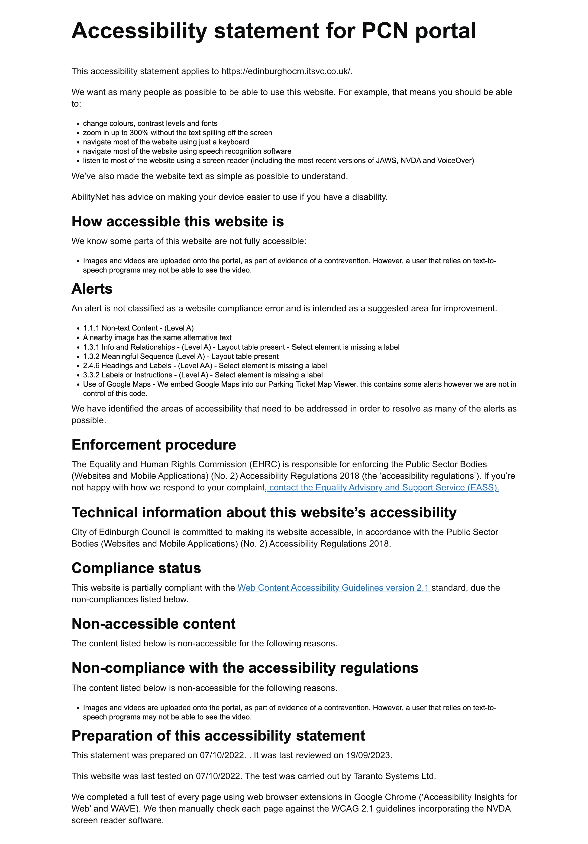
Let’s have a look at the accessibility statement
https://edinburghocm.itsvc.co.uk/Home/Accessibility
It was last tested in 2022 using a browser extension and with screen reader software.
Says that the portal is accessible apart from:
Inaccessible images and videos for parts of evidence
alerts that are not a compliance error but could be improved

Slide 20
Takeaway
Just because something has an accessibility statement does not mean that it is accessible or usable.

Slide 21
Today’s focus is one specific question
Scenario You have been asked to develop a digital version of a paper-based form. One of the form fields is ‘phone number’ - today we’ll focus on this field in our design backlog.
We’ll think about “What’s the best way to ask for a phone number?”
What could possibly go wrong?

Slide 22
Think about services and phone numbers
If you have designed or worked on a service that included a question about a phone number,
please raise your hand

Slide 23
Share your thoughts about phones
Have a look at your phone
Is there only one or do you have several?
Consider calls received and messages
What did you get and why?
How did you react?
Any extra thoughts?

Slide 24
Agenda
✓ Introduction
Challenge 1: Think about types of disability
Challenge 2: Use the Web Content Accessibility Guidelines
Challenge 3: Use a Web Design System
Challenge 4: Think about why we ask for a phone number
Challenge 5: Make a question protocol
Challenge 6: Make a prototype
Challenge 7: Think about implementation (and code)
Wrap up

Slide 25
Challenge 1: Think about types of disability
Think about someone you know, maybe in your family, who has a different experience to you with their phone
Share your stories on your table (2 minutes)
Feedback
Did any story from your table include a disabled person or someone with a disability?

Slide 26
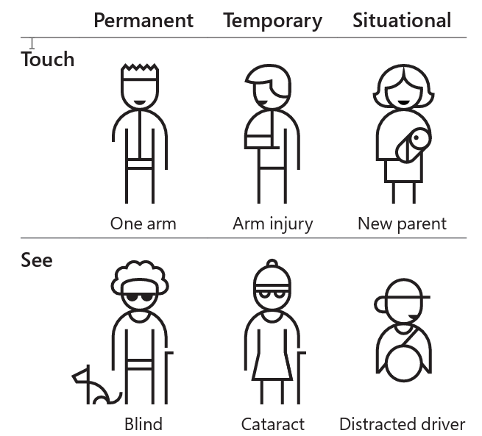
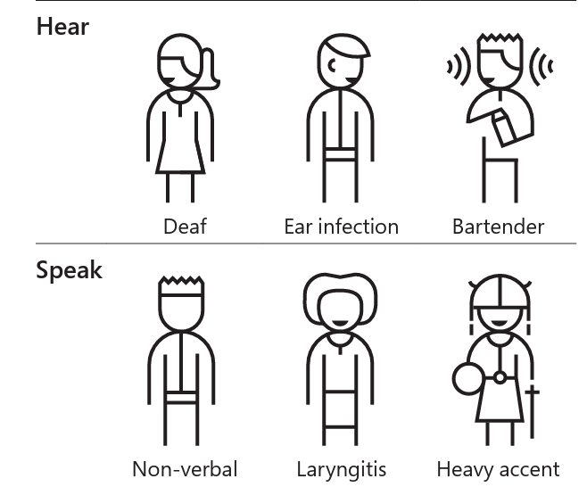
Consider permanent, temporary, and situational disabilities
https://inclusive.microsoft.design/tools-and-activities/Inclusive101Guidebook.pdf

Slide 27
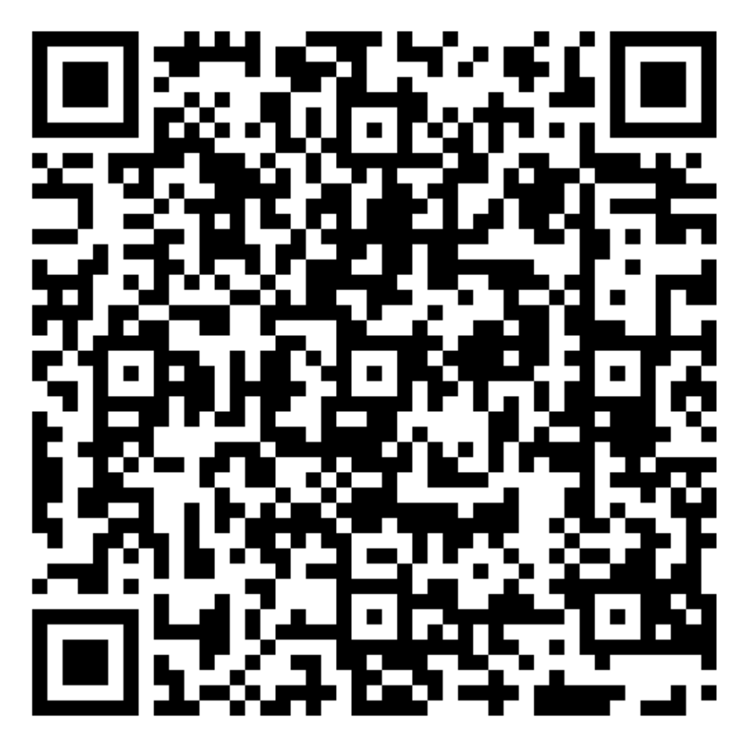
Keep ONE person in mind for this workshop
Please choose one person who has a permanent, temporary, or situational disability that affects how they use a phone
Share your choice with your table
You may want to change your choice when you hear the others
https://inclusive.microsoft.design/tools-and-activities/Inclusive101Guidebook.pdf

Slide 28
Agenda
✓ Introduction
✓ Challenge 1: Think about types of disability
Challenge 2: Use the Web Content Accessibility Guidelines
Challenge 3: Use a Web Design System
Challenge 4: Think about why we ask for a phone number
Challenge 5: Make a question protocol
Challenge 6: Make a prototype
Challenge 7: Think about implementation (and code)
Wrap up

Slide 29
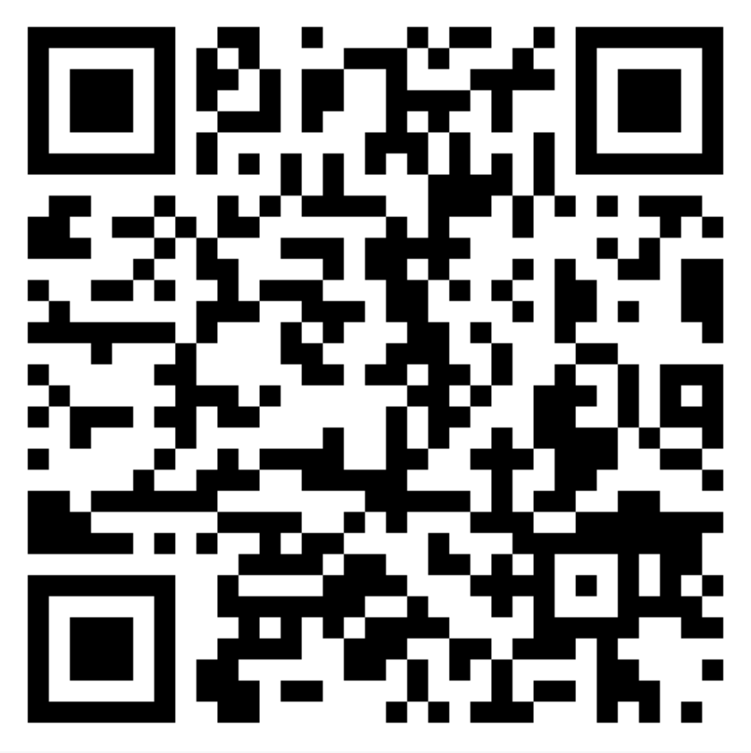
Challenge 2: Use the Web Content Accessibility Guidelines
Let’s try to get some help from WCAG for “the best way to ask for a phone number”
Have a look at the Forms Tutorial from the Web Accessibility Initiative (WAI) from the W3C https://www.w3.org/WAI/tutorials/forms/
Compare notes
5 minutes

Slide 30
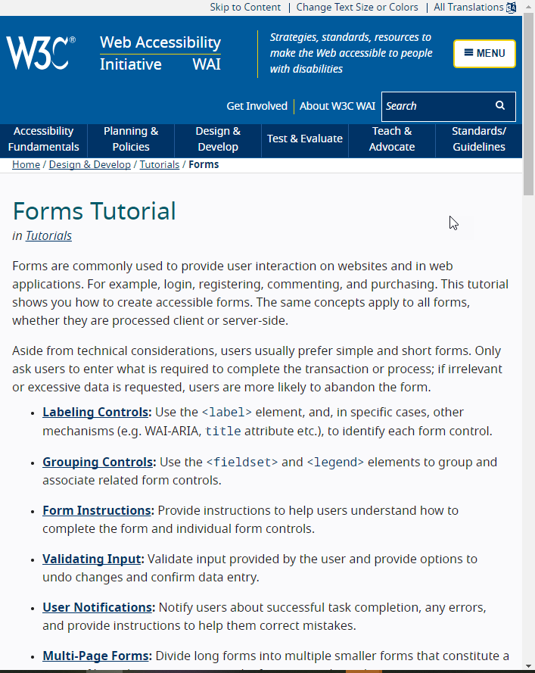
This tutorial is mostly about interaction design, with a bit of content design
https://www.w3.org/WAI/tutorials/forms/

Slide 31
There is a bit of service design there

Slide 32
Agenda
✓ Introduction
✓ Challenge 1: Think about types of disability
✓ Challenge 2: Use the Web Content Accessibility Guidelines
Challenge 3: Use a Web Design System
Challenge 4: Think about why we ask for a phone number
Challenge 5: Make a question protocol
Challenge 6: Make a prototype
Challenge 7: Think about implementation (and code)
Wrap up

Slide 33
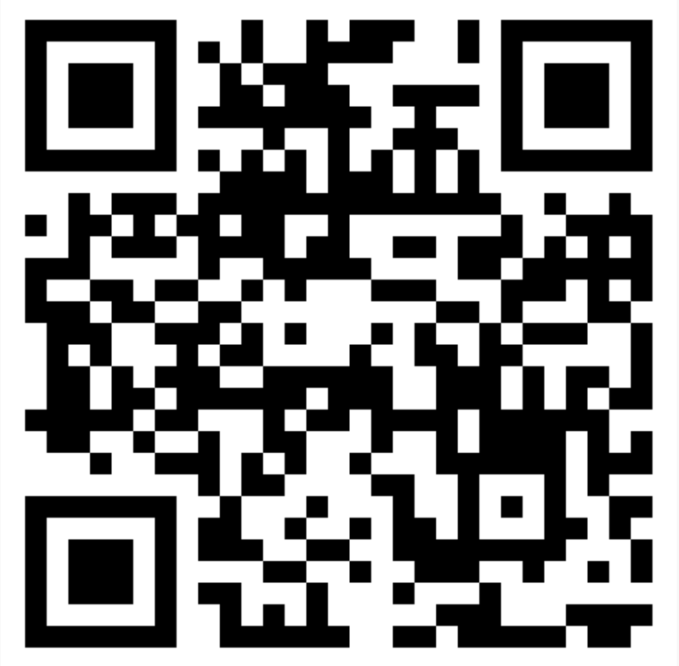
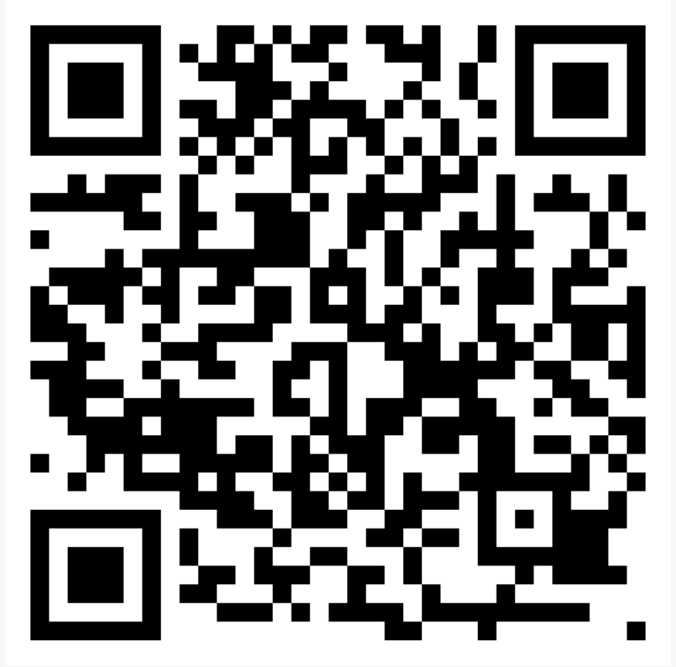
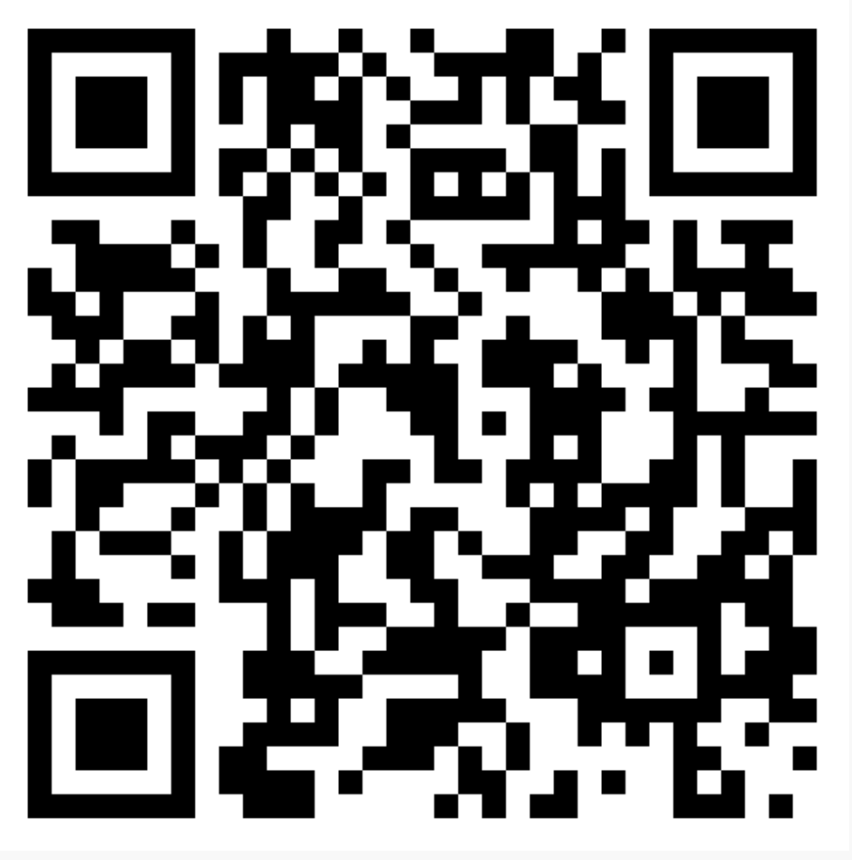
Challenge 3: Use a Web Design System
We’re looking for the best way to ask for a phone number
Please choose ONE of these
Compare notes
5 minutes
Scottish Gov Design System designsystem.gov.scot
US Design System designsystem.digital.gov
GOV.UK Design System design-system.service.gov.uk/

Slide 34
What did you find in the design systems?
Did the design system you chose have guidance that helped?

Slide 35
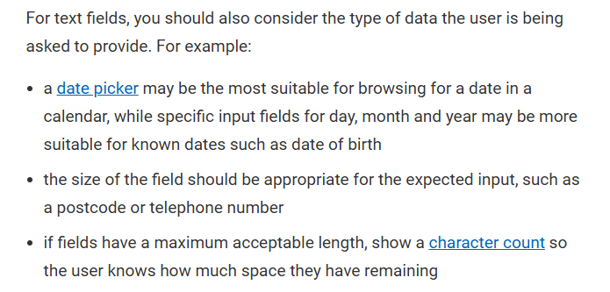
The Scottish design system has this advice
https://designsystem.gov.scot/guidance/forms/form-design

Slide 36
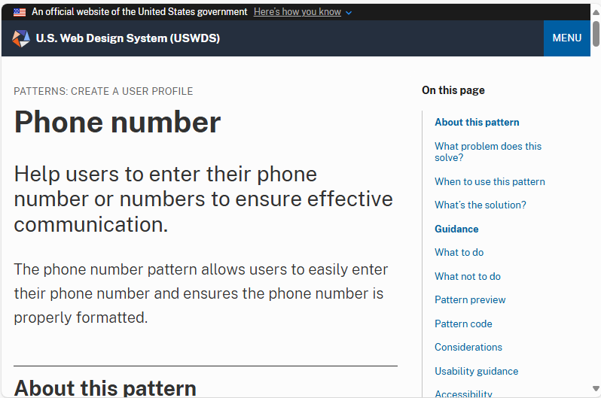
USDS has a pattern specifically about phone numbers
https://designsystem.digital.gov/patterns/create-a-user-profile/phone-number/

Slide 37
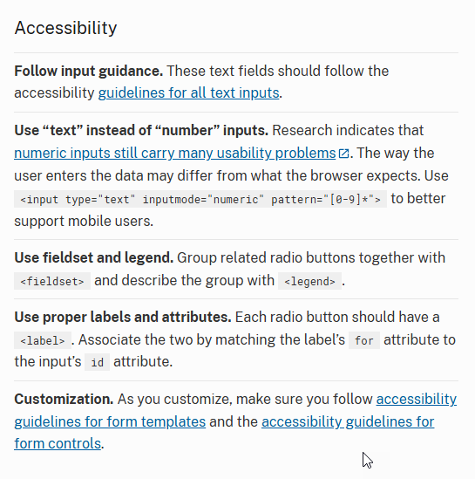
The accessibility guidance is OK, but doesn’t help someone who can’t use a phone at all What about the person you’re thinking about?
https://designsystem.digital.gov/patterns/create-a-user-profile/phone-number/

Slide 38
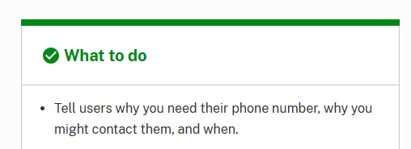
We have been told to think about service design
WCAG
USDS

Slide 39
Agenda
✓ Introduction
✓ Challenge 1: Think about types of disability
✓ Challenge 2: Use the Web Content Accessibility Guidelines
✓ Challenge 3: Use a Web Design System
Challenge 4: Think about why we ask for a phone number
Challenge 5: Make a question protocol
Challenge 6: Make a prototype
Challenge 7: Think about implementation (and code)
Wrap up

Slide 40
Challenge 4: Think about why we ask for a phone number
Any stories to share about:
Why organisations ask for a phone number?
How will they use the number?
When might they use it?
Does that use of the phone number cause any difficulties for the person that you are thinking about?
Choose a story from your table to share with the room

Slide 41
Phone numbers are for more than conversation
Calling someone to talk to them
Text (SMS) messages about the progress of an order or task
Two factor authentication
Helping to identify someone, maybe as a recovery mechanism
… maybe some other things too

Slide 42
Agenda
✓ Introduction
✓ Challenge 1: Think about types of disability
✓ Challenge 2: Use the Web Content Accessibility Guidelines
✓ Challenge 3: Use a Web Design System
✓ Challenge 4: Think about why we ask for a phone number
Challenge 5: Make a question protocol
Challenge 6: Make a prototype
Challenge 7: Think about implementation (and code)
Wrap up

Slide 43
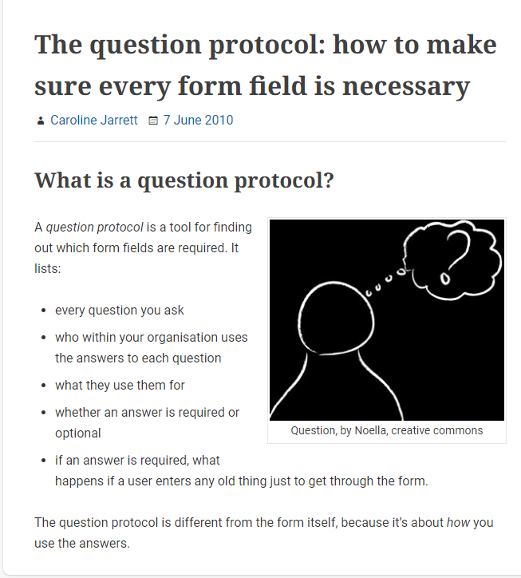
A question protocol is a list of all the questions
The question protocol: how to make sure every form field is necessary
https://www.effortmark.co.uk/question-protocol-make-sure-every-form-field-necessary/

Slide 44
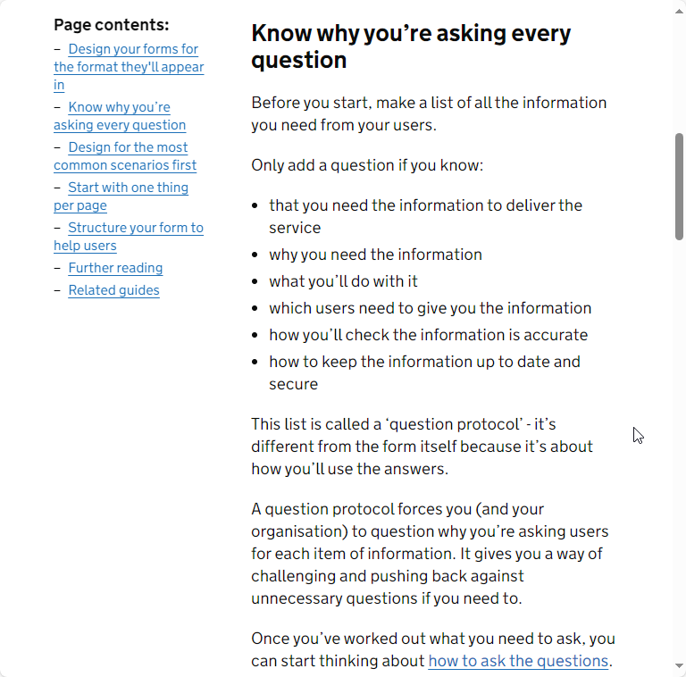
Question protocols are in the GOV.UK Service Manual
Structuring forms - Service Manual - GOV.UK (www.gov.uk)
https://www.gov.uk/service-manual/design/form-structure

Slide 45
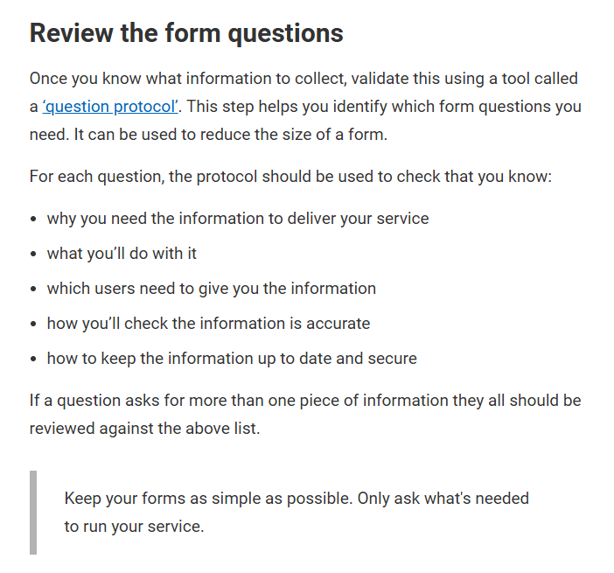
The Scottish government also has question protocols
Form content - Design System
https://designsystem.gov.scot/guidance/forms/form-content
(links to the GOV.UK advice)

Slide 46
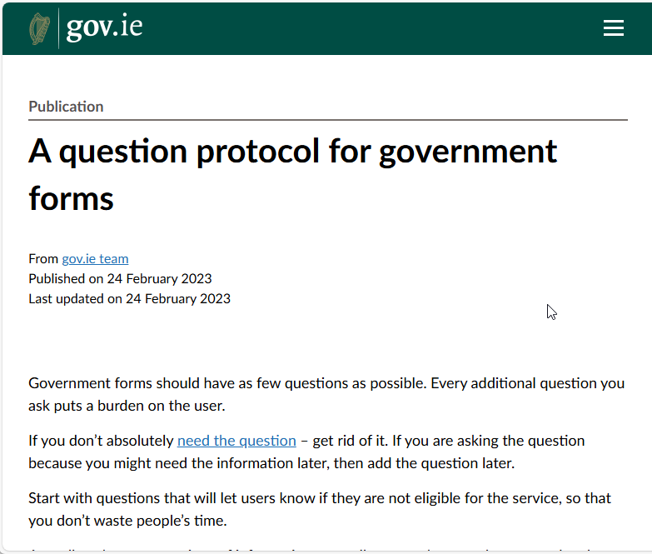
The Irish government has question protocols too
gov - A question protocol for government forms
https://www.gov.ie/en/publication/a5609-a-question-protocol-for-government-forms/

Slide 47
A question protocol keeps track of each question
Only add a question if you know:
that you need the information to deliver the service
why you need the information
what you’ll do with it
which users need to give you the information
how you’ll check the information is accurate
how to keep the information up to date and secure
Structuring forms - Service Manual - GOV.UK (www.gov.uk)

Slide 48
An example of an entry in my question protocol
Column in the question protocol | Example for a newsletter sign-up form
Answer we need to get (data) | Name
Why is it needed? | To be able to address the user To identify the individual user
How will it be used? | Hi, Caroline!
Level of importance (must have, nice to have) | Nice to have
What happens if you get the wrong answer or no answer to this question? | May have a strange interaction with the user
(optional: extra questions that you think will be helpful for your designs and organisation)

Slide 49
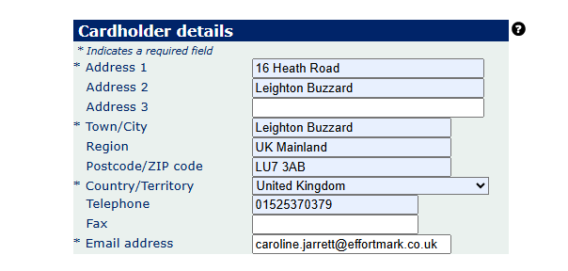
Sometimes questions linger past their usefulness

Slide 50
We have some more information on the scenario
Scenario You have been asked to develop a digital version of a paper-based form. One of the form fields is ‘phone number’ - today we’ll focus on this field in our design backlog.
The form is to sign up for a patient advisory group at a GP practice.
They want the phone number so that they can call the volunteer patient to chat about the duties of the advisory group.

Slide 51
Challenge 5: Let’s make an entry for phone number
The form is to sign up for a patient advisory group at a GP practice.
They want the phone number so that they can call the volunteer patient to chat about the duties of the advisory group.
Column in the question protocol | Entry for our phone number scenario
Answer we need to get (data) | Phone number
Why is it needed?
How will it be used?
Level of importance (must have, nice to have)
What happens if you get the wrong answer or no answer to this question?
Anything else you want to discuss with this client?
Column in the question protocol - Google Docs

Slide 52
Agenda
✓ Introduction
✓ Challenge 1: Think about types of disability
✓ Challenge 2: Use the Web Content Accessibility Guidelines
✓ Challenge 3: Use a Web Design System
✓ Challenge 4: Think about why we ask for a phone number
✓ Challenge 5: Make a question protocol
Challenge 6: Make a prototype
Challenge 7: Think about implementation (and code)
Wrap up

Slide 53
Challenge 6: Make a prototype – in pairs or threes
Design a truly accessible question for asking for a phone number for the scenario
Your question must:
Obtain a phone number
Be ready for testing in 5 minutes!
HINT
Allow for some sort of choice about method of contact

Slide 54
Challenge 6: Test your prototypes
Decide which person in your pair/three will be the participant for another team
Swap participants and test

Slide 55
Consider* a filter question to introduce the topic

Slide 56
Consider* a filter question to introduce the topic
* Try doing a filter question, then actually test it with some real people to make sure that the question itself is not repellent

Slide 57
It’s worth putting extra effort into ‘easy’ questions
Question | Mean abandon rate
Name | 6%
Email | 6%
Password | 11%
Phone | 6%
Postcode | 5%
Address | 5%
https://www.zuko.io/blog/which-form-fields-cause-the-biggest-ux-problems

Slide 58
Users want to know why you want to know
“Users hate giving you their phone number - It’s a sad truth but users are very suspicious of you asking for their number. They fear being spammed by sales calls so would rather drop out of the process than hand it over …
If you really must ask then explain why you need it. A simple line saying that you need their number in case there are any issues with delivery will do wonders for the completion rate on your phone field.”
https://www.zuko.io/blog/which-form-fields-cause-the-biggest-ux-problems

Slide 59
Forgiving interaction design really matters, too
“Format confusion - More than any field, phone numbers have a cornucopia of ways you can potentially enter the information. Do you add a ‘+’? The country code? How about spaces or dashes? <HEAD EXPLODES EMOJI>”
https://www.zuko.io/blog/which-form-fields-cause-the-biggest-ux-problems

Slide 60
Please help us: people with dyscalculia
If you already have a phone number for us, don’t ask again
Allow for typical characters such as + - ( ) and space
Be very specific in the error message
Give us extra time
Let us copy/autocomplete the phone number into the form
https://accessiblenumbers.com/fill-in-the-information-you-have
https://baymard.com/blog/adaptive-validation-error-messages

Slide 61
Takeaway
Include disabled people and people with disabilities in your team
Diversity wins

Slide 62
Agenda
✓ Introduction
✓ Challenge 1: Think about types of disability
✓ Challenge 2: Use the Web Content Accessibility Guidelines
✓ Challenge 3: Use a Web Design System
✓ Challenge 4: Think about why we ask for a phone number
✓ Challenge 5: Make a question protocol
✓ Challenge 6: Make a prototype
Challenge 7: Think about implementation (and code)
Wrap up

Slide 63
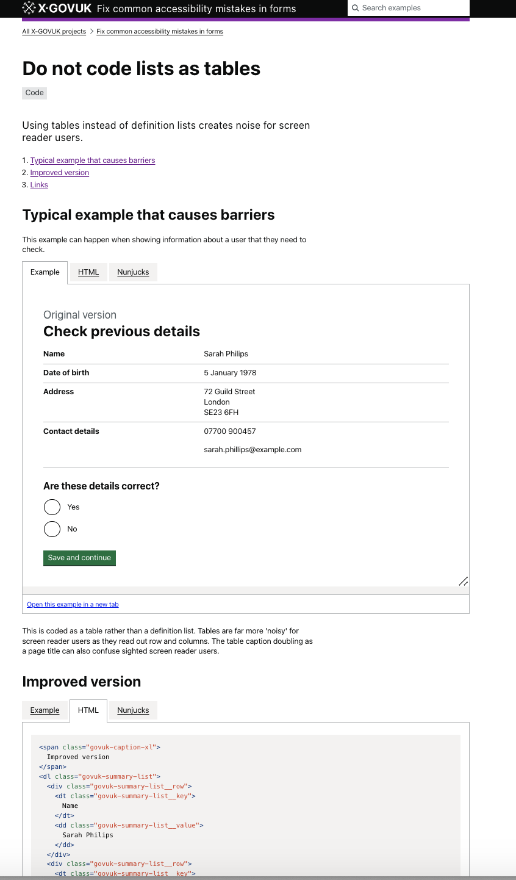
Code must work correctly, too
Even if you design something right, it can be coded in an inaccessible way
There is a community group collecting examples on
https://x-govuk.github.io/govuk-accessibility-mistakes-forms

Slide 64
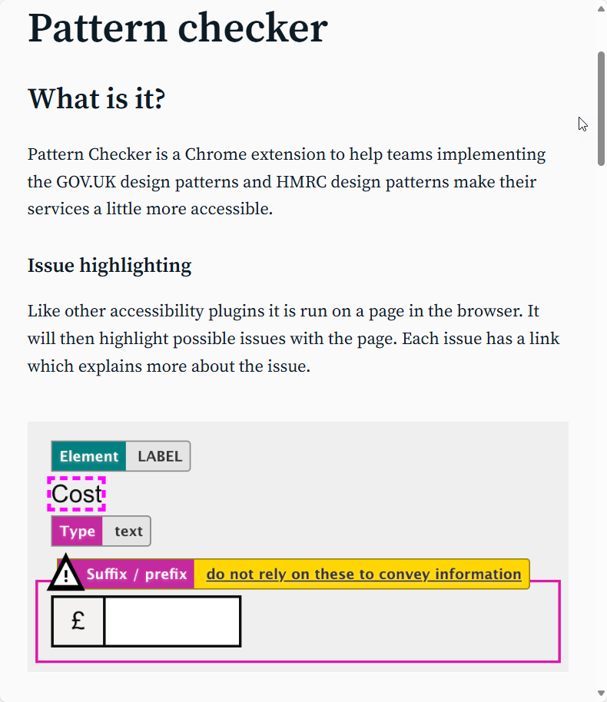
Adam Liptrot’s pattern checker is a massive help
https://liptrot.org/pattern-checker/

Slide 65
Agenda
✓ Introduction
✓ Challenge 1: Think about types of disability
✓ Challenge 2: Use the Web Content Accessibility Guidelines
✓ Challenge 3: Use a Web Design System
✓ Challenge 4: Think about why we ask for a phone number
✓ Challenge 5: Make a question protocol
✓ Challenge 6: Make a prototype
✓ Challenge 7: Think about implementation (and code)
Wrap up

Slide 66
A good form needs a lot of accessibility
Interaction design
Content design
Service design

Slide 67
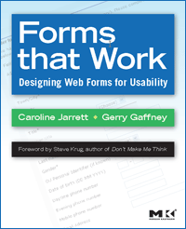
Ask us questions: Caroline Jarrett and Vicky Teinaki
Social media @cjforms
caroline.jarrett@effortmark.co.uk
www.effortmark.co.uk
Social media @vickytnz
Vicky@VickyTeinaki.com
www.VickyTeinaki.com

